Slide 1

ABC to Machine Learning
-Xinyu Zhong
Notes:
I wou

Slide 2
Supervised Learning | Model
Regression& Classification | Decision Tress
 | Regression Analysis
 | Neural Network
Classification | Deep Neural Network
 | Gaussian Process, etc.
Application of ML in Physics Research (Astrophyisc, particle phyiscs, material science)

Slide 3
Usage of ML technique in physics research

Slide 4
Classification and Regression
 | Classification | Regression
Predicted Variable, f(x) | A discrete quantity | A continuous quantity
Examples | Decision Trees | Linear Regression, Polynomial Regression, Neural Network, Gaussian Regression
Example of application in physics research | Categorization of stars, galaxy, clusters. Measuring photometric redshifts using galaxy images and Deep Neural Networks. | Linear Regression
Evaluation of performance of Model | Accuracy, Precision, F1-Metric, Confusion Matrix | Mean square error, Root mean square
Notes:
Measuring photometric redshifts using galaxy images and Deep Neural Networks
https://www.sciencedirect.com/science/article/pii/S221313371630021X

Slide 5
Common Machine Learning Methods
ML Method | Requirement for data optimal perforamce | Cost of computational resources | Interpretibility | Difficulty in deployment | Other advangtage/limitation
Decision Tree | Little requirement | Relatively few | Good with a nice visualisation (tree diagram) |  | Limited capability for regression, Prone to overfitting
Linear Regression | Average | Relatively few | Good |  | Could not handle non-linear cases
Neural Network | Large | Computationally Expensive | Black-box, hard to interpret result
Deep Neural Network | Large | Even more Computationally Expensive | Black-box, hard to interpret result
Gaussian Process | Perform well with limited amount of data points | Computationally expensive | Black-box, hard to interpret result

Slide 6
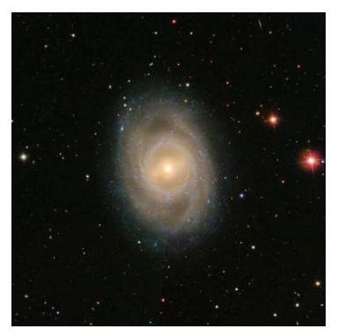
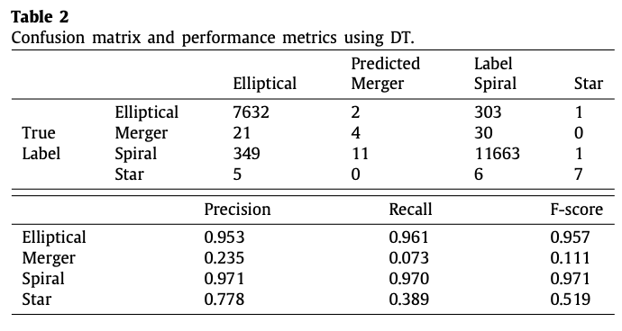
DT example: Galaxy morphological classification
Galaxy morphological classification is a system used by astronomers to divide galaxies into groups based on their visual appearance. E.g. Elliptical galaxies, Spiral galaxies, Star, Mergers
Notes:
https://www.sciencedirect.com/science/article/pii/S2213133721000469?pes=vor

Slide 7
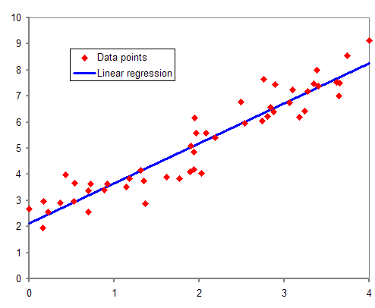

Regression Analysis
Various types of Linear Regression, Polynomial Regression, Kernel Regression
Example: Multivariable Linear Regression
Expressed as :
$$\begin{matrix} & \overset{ˆ}{y}=β_{0}+β_{1}x_{1}+β_{2}x_{2}+…+β_{m}x_{m}+ε \\ & =β_{0}+∑^{m} β_{i}x_{i}+ε\end{matrix}$$
Find the value of the coefficients by minimising the loss function
Notes:
When we have more than one input we can use Ordinary Least Squares to estimate the values of the coefficients.
Gradient descent finds the linear model parameters iteratively.
OLS is not an iterative process, it uses multivariate calculus to solve an equation, which is inefficient if you have a big dataset and will fail if there is mathematically no solution for the probelm

Slide 8
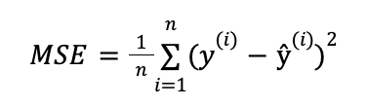
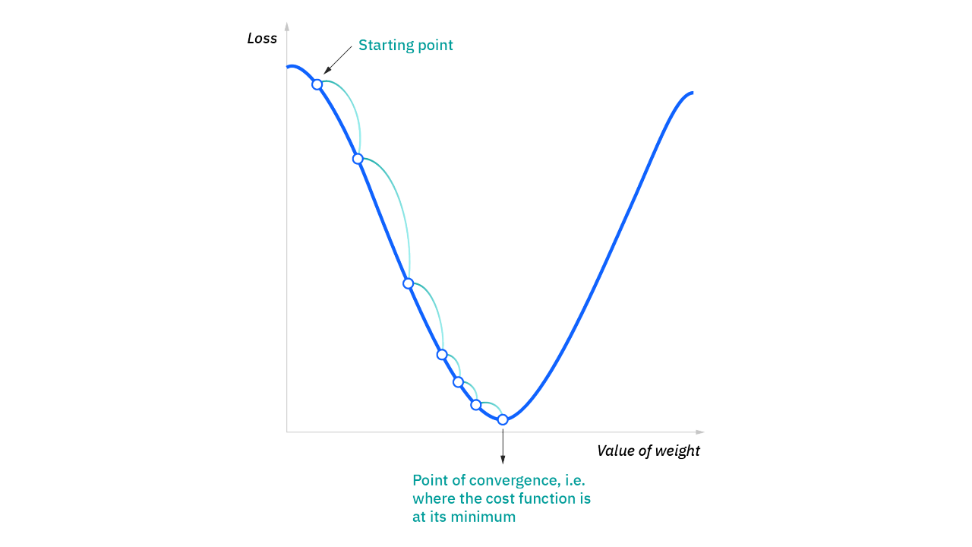

Regression Analysis – Parameters
Finding the parameters
Regression written in the form of
$$\begin{matrix} & \overset{ˆ}{y}=β_{0}+β_{1}x_{1}+β_{2}x_{2}+…+β_{m}x_{m}+ε \\ & =β_{0}+∑^{m} β_{i}x_{i}+ε\end{matrix}$$
We find the parameters by minimising the loss function:
Gradiant Decent
A more practical approach when dealing with multivariable regression problems
by iteratively minimizing the error of the model on your training data.

Slide 9
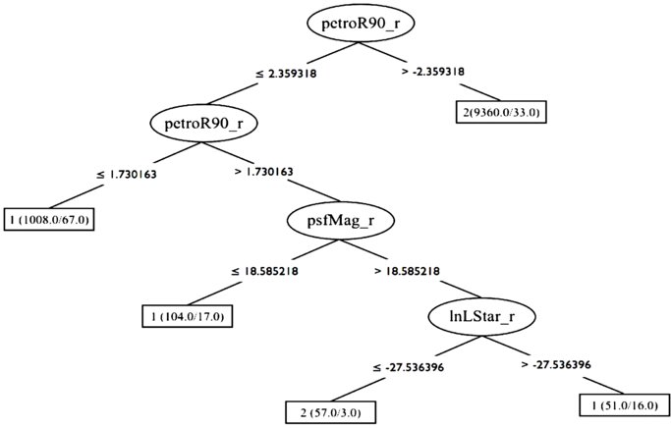
Decision Tree
A Decision starts with a root node followed by a series of branches and internal nodes and ends with a leaf node.
Notes:
A decision tree is a non-parametric supervised learning algorithm, which is utilized for both classification and regression tasks.
https://towardsdatascience.com/decision-trees-explained-entropy-information-gain-gini-index-ccp-pruning-4d78070db36c#:~:text=In%20the%20context%20of%20Decision,only%20pass%20or%20only%20fail.

Slide 10
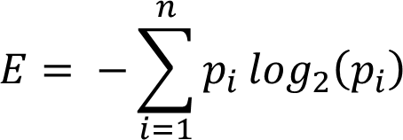

Decision Tree
Variable selection criterion in Decision Trees can be done via two approaches:
1. Minimising entropy and Information Gain
2. Gini Index
Entropy
A measure of disorder or impurity in a node.
Gini Index
A measure of the probability for a random instance being misclassified when chosen randomly
Notes:
Here is where the true complexity and sophistication of decision lies. Variables are selected on a complex statistical criterion which is applied at each decision node. Now, variable selection criterion in Decision Trees can be done via two approaches:
1. Entropy and Information Gain
2. Gini Index
Information Gain = Entropy_Parent — Entropy_child, we want to maximise Information gain and reduce entropy.
Gini Index or Impurity measures the probability for a random instance being misclassified when chosen randomly. The lower the Gini Index, the better the lower the likelihood of misclassification.
https://towardsdatascience.com/decision-trees-explained-entropy-information-gain-gini-index-ccp-pruning-4d78070db36c#:~:text=In%20the%20context%20of%20Decision,only%20pass%20or%20only%20fail.

Slide 11
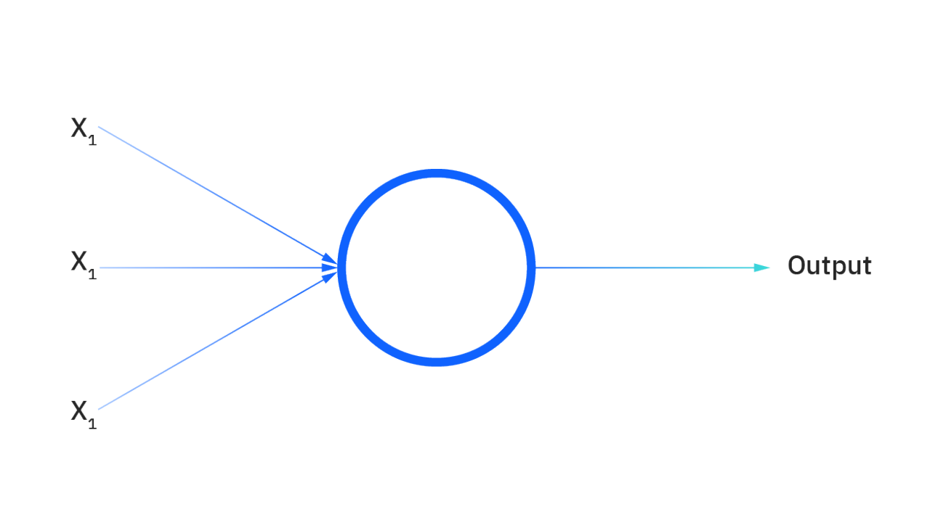
Neural Network
Layers
Consists of input, hidden layers and outpu
Neurons
Weights of each prameter (w_i)
Bias
Activation Function
Bias (b)
Activation Function
How does Neural Work works
Weights help determine the importance of any given variable.
All inputs are then multiplied by their respective weights and then summed.
Output is passed through an activation function, which determines the output. If that output exceeds a given threshold, it “fires” (or activates) the node, passing data to the next layer in the network.

Slide 12
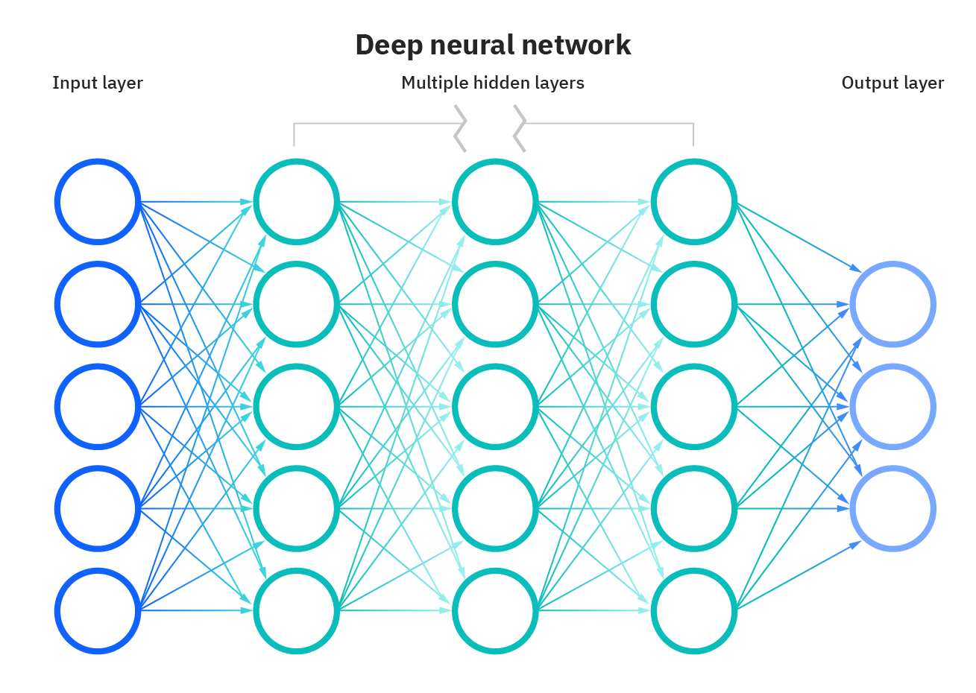
Deep Neural Network
Depth refers to the hidden layers in a neural network,
Application of DNN:
Measuring photometric redshifts using galaxy images and Deep
Neural Networks
Notes:
Application of Neural Network
Hoyle, B. (2016). Measuring photometric redshifts using galaxy images and deep neural networks. Astronomy and Computing, 16, 34–40.
https://www.sciencedirect.com/sdfe/reader/pii/S221313371630021X/pdf

Slide 13
Validation of ML
How do me measure the accuracy of ML
Cross validation
4:1 Ratio
Measurement the performance of the ML?
Regression: Mean square error
Classification:
Accuracy, Confusion Matrix, F1-score(harmonic mean of accuracy and precision)
Complexity of the Model
For example, DNN takes many orders of magnitude more computing resources in comparison to standard ML techniques
Notes:
The most common approach is to split the training set into two subsets, usually in a 4:1 ratio, and construct a tree with the larger subset and apply it to the smaller. A more sophisticated method is called Cross Validation (CV; Witten & Frank 2000). The CV method, which is used here, consists of splitting the training set into 20 subsamples, each with the same distribution of classes as the full training set. While the number of subsamples, 20, is arbitrary, each subsample must provide a large training set for the CV method. For each subsample, a DT is built and applied to the other 19 subsamples. The resulting completeness and contamination functions are then collected and the median and dispersion over all subsets is found. This gives the CV estimate of the robustness in terms of a completeness function.
https://iopscience.iop.org/article/10.1088/0004-6256/141/6/189#aj385906s3 THIS LINK CONTAINS IOP ARTICLE WHICH MENTIONED VALIDATION IN THE END OF SECTION 3

Slide 14
Performance

